Slide 1



Data Science and Machine Learning
Generative AI

Slide 2
Agenda
LLMs, Chatbots, Model vs Products and concepts
(Part of W1 + Somethign on APIs etc)
Model Architecture: S4-S62 of W1
Exercise on

Slide 3
Generative AI & Large Language Models

Slide 4
Generative AI
ChatBot
Who designed the street layout of Washington DC?
T
The street layout of
Washington D.C. was designed by Pierre Charles L'Enfant, a French-born American architect and civil engineer.

Slide 5
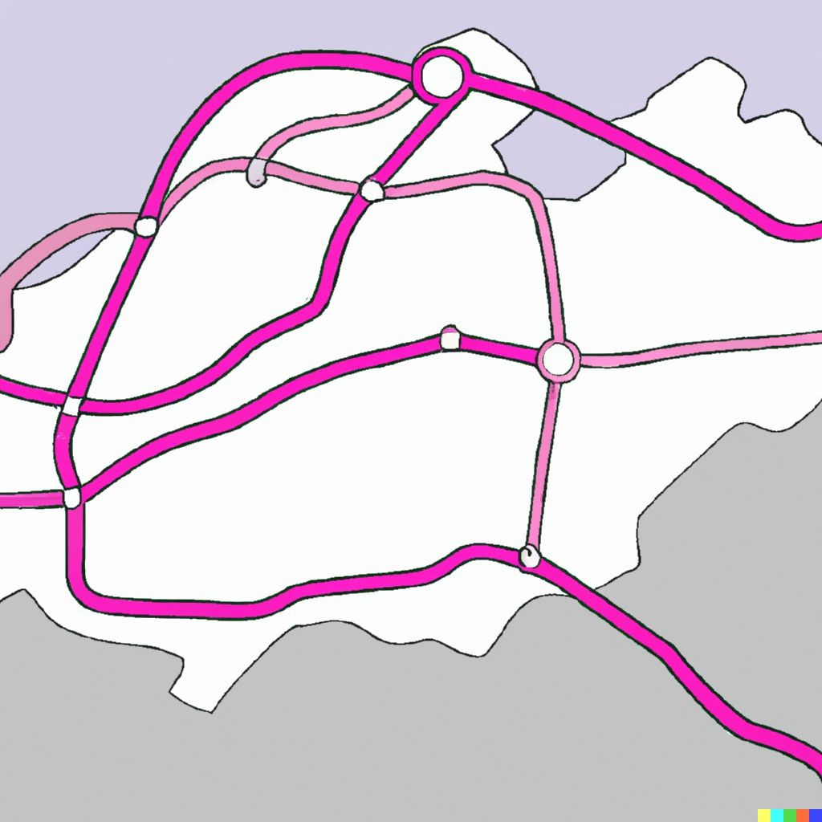
Generative AI
pAIntBox
What do you want to create?
An | imaginary | subway | map
in | a coastal | city.
Image dimensions:
by
(Max 2048)
Generate

Slide 6

Large Language Models
BLOOM
GPT
LLaMa
BERT
PaLM
FLAN-T5

Slide 7



Prompts and completions
Prompt
Model
Completion
Where is Ganymede located in the solar system?
Where is Ganymede located in the solar system?
LLM
Ganymede is a moon of Jupiter and is located in the solar system within Jupiter’s orbit.
Context window
For exemple, a few 1000 words.

Slide 8
Use cases & tasks

Slide 9
LLM chatbot
ChatBot
Who designed the street layout of Washington DC?
T

Slide 10
LLM chatbot
ChatBot
Who designed the street layout of Washington DC?
T
The street layout of
Washington D.C. was designed by Pierre Charles L'Enfant, a French-born American architect and civil engineer.

Slide 11
LLM use cases & tasks
Essay Writing
Summarization
Translation

Slide 12
LLM use cases & tasks
Essay Writing
Summarization
Translation
Information retrieval
Invoke APIs and actions
Action call
External Applications

Slide 13
The significance of scale: language understanding
BERT* 110M
*Bert-base
BLOOM 176B

Slide 14
How LLMs work - Transformers architecture

Slide 15
Generating text with RNNs
RNN

Slide 16
Generating text with RNNs
?
The milk is bad, my tea
tastes …
great.
RNN

Slide 17
Generating text with RNNs
?
The milk is bad, my
tea tastes …
great.
RNN

Slide 18
Generating text with RNNs
?
The milk is bad
, my tea tastes …
great.
RNN

Slide 19
Generating text with RNNs
?
The milk is bad
, my tea tastes great.
RNN

Slide 20

Generating text with RNNs
The milk is bad, my tea tastes great.
RNN

Slide 21

Understanding language can be challenging
I took my money to the bank.
River bank?

Slide 22
Understanding language can be challenging
The teacher’s book?
The teacher taught the student with the book.
The student’s book?

Slide 23
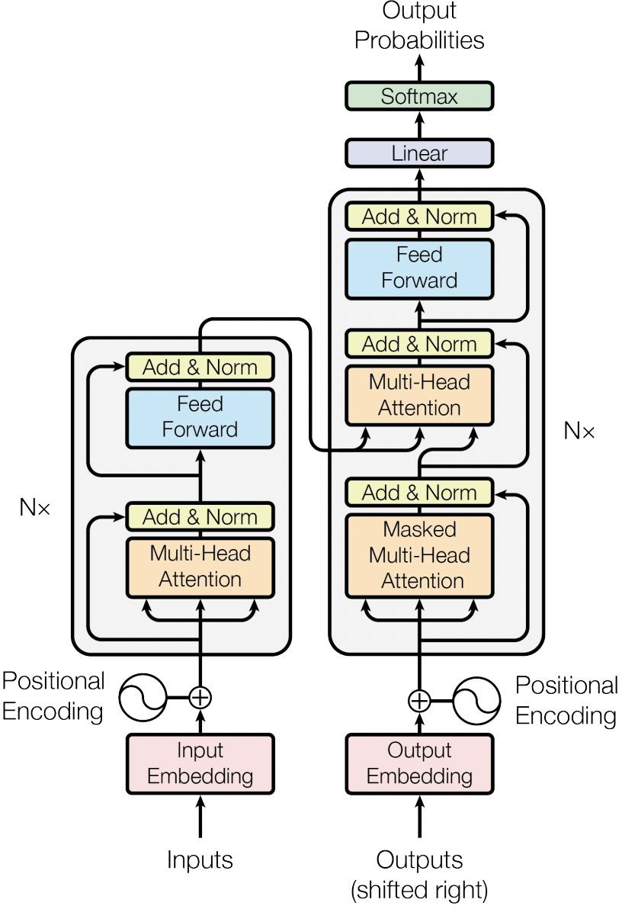

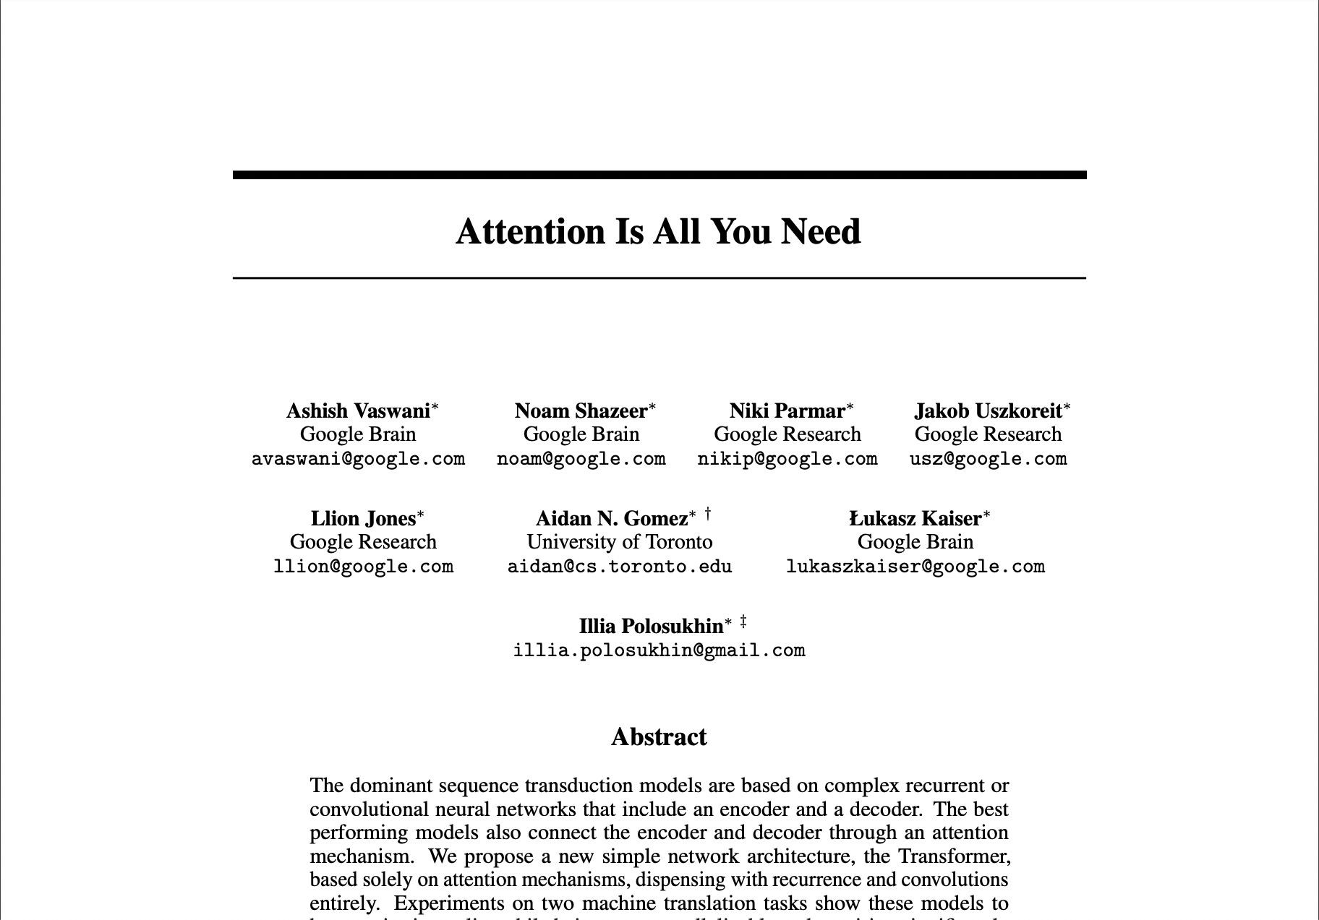
Transformers

Slide 24
Transformers
Scale efficiently
Parallel process
Attention to input meaning

Slide 25
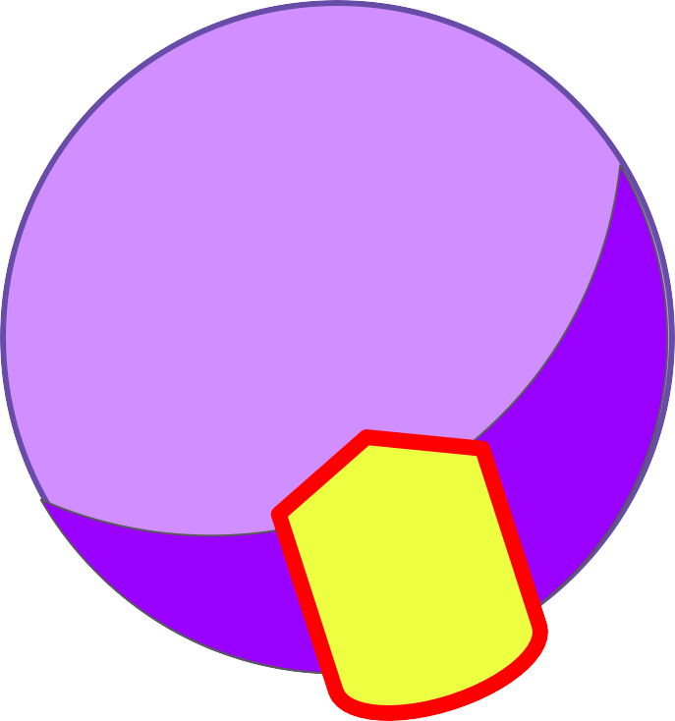

Transformers
RNN
LLM
L

Slide 26

Transformers
The teacher taught the student with the book.

Slide 27
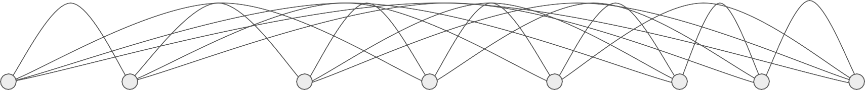
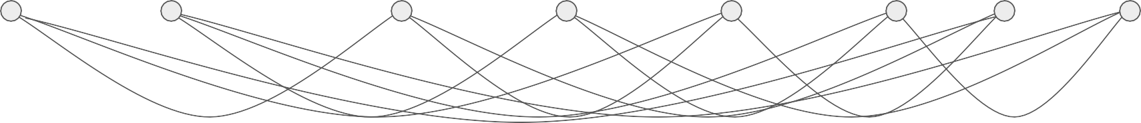
Transformers
The teacher taught the student with the book.

Slide 28
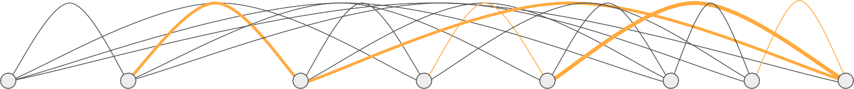
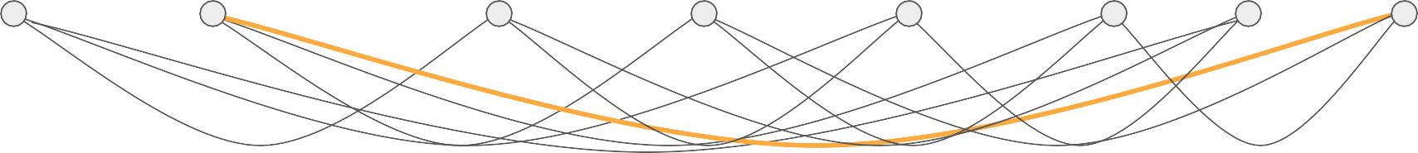
Transformers
The teacher taught the student with the book.

Slide 29
Self-attention
The teacher taught
the student
with
a book
.
The teacher taught the student with
a book
.

Slide 30
Self-attention
The teacher taught
the student
with
a book
.
The teacher taught the student with
a book
.

Slide 31
Transformers

Slide 32
Transformers
Output
Softmax output
Decoder
Encoder
Embedding
Embedding
Inputs

Slide 33

Transformers
Decoder
Encoder
Embedding
Embedding
Inputs
Tokenizer
342 | 879 | 432 | 342
Token IDs
Input:
the teacher
taught the

Slide 34
Transformers
Decoder
Encoder
Embedding
Embedding
Inputs
Tokenizer
156 | 790 | 321 | 890 | 156
Token IDs
Input:
the teach er taught the

Slide 35


Transformers
Output
Softmax output
Decoder
Encoder
Embedding
Embedding
Embedding
Embedding
Inputs

Slide 36
Transformers
Output
Softmax output
Decoder
Encoder
ding Embedding Embedding Embedding
Inputs
X₁
X₂
X₃
X₄
e.g. 512
z
342 | 879 | 432 | 342
Embed
Embedding

Slide 37
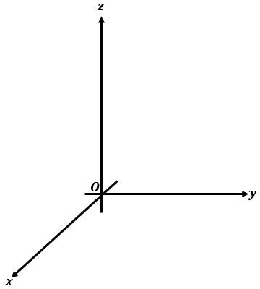


Transformers
fire
fox
student
book
internet
computer

Slide 38
Transformers
fire
fox
student
book
internet
computer

Slide 39
Transformers
fire
fox
student
book
internet
computer
Angle measures distance between words

Slide 40

Transformers
Output
X₁
X₂
X₃
S
o o
ftm
utp
Position embeddings
+
X₁
X₂
X₃
D
c
er
Token embeddin_{g}
der
Positional Encoding
Positional Encoding
Embedding
Embedding
Inputs

Slide 41


Transformers
Output
Softmax output
Decoder
Encoder
Self-attention
Self-attention
Embedding
Embedding
Inputs

Slide 42


Transformers
Output
Softmax output
Decoder
EEnEncnccododeder er r
Multi-headed Self-attention
Multi-headed Self-attention
Embedding
Embedding
Inputs

Slide 43


Transformers
Output
Softmax output
Feed forward network
Feed forward network
Decoder
Encoder
Embedding
Embedding
Inputs

Slide 44
Transformers
Output
Softmax output
P1 P2 … … … … … … … … … … … … … … … …
Decoder
… … … … … … … … … …
…
Pn
Encoder
Embedding
Embedding
Inputs

Slide 45
Transformers
Output
Translation:
sequence-to-sequence task
Softmax output
J'aime l'apprentissage automatique
Decoder
Encoder
Embedding
Embedding
Inputs

Slide 46
Transformers
Output
Translation:
sequence-to-sequence task
Softmax output
J'aime l'apprentissage automatique
Decoder
Encoder
J’a
l'apprentissage
automatique
ime
2345
3425
3853
Embedding
Embedding
Inputs

Slide 47
Transformers
Output
Translation:
sequence-to-sequence task
Softmax output
J'aime l'apprentissage automatique
Decoder
Encoder
J’a
l'apprentissage
automatique
ime
2345
3425
3853
Embedding
Embedding
Inputs

Slide 48
Transformers
Output
Translation:
sequence-to-sequence task
Softmax output
J'aime l'apprentissage automatique
Decoder
Encoder
J’a
l'apprentissage
automatique
ime
2345
3425
3853
Embedding
Embedding
Inputs

Slide 49
Transformers
Output
Translation:
sequence-to-sequence task
Softmax output
J'aime l'apprentissage automatique
Decoder
Encoder
J’a
l'apprentissage
automatique
ime
2345
3425
3853
Embedding
Embedding
Inputs

Slide 50
Transformers
Output
297
Translation:
sequence-to-sequence task
Softmax output
J'aime l'apprentissage automatique
Decoder
Encoder
J’a
l'apprentissage
automatique
ime
2345
3425
3853
Embedding
Embedding
Inputs

Slide 51
Transformers
Output
297
450
901
389
Translation:
sequence-to-sequence task
Softmax output
J'aime l'apprentissage automatique
Decoder
Encoder
J’a
l'apprentissage
automatique
ime
2345
3425
3853
Embedding
Embedding
Inputs

Slide 52

Transformers
Output
297
450
901
389
Translation:
sequence-to-sequence task
Softmax output
I
love
machine
learning
J'aime l'apprentissage automatique
Decoder
I love machine learning
Encoder
J’a
l'apprentissage
automatique
ime
2345
3425
3853
Embedding
Embedding
Inputs

Slide 53
Transformers
Output
Softmax
Softmax output
output
Decoder
Encoder
Embedding
Embedding
Inputs

Slide 54
Transformers
Output
Softmax output
Encoder
Encodes inputs (“prompts”) with contextual understanding and produces one vector per input token.
Decoder
Accepts input tokens and generates new tokens.
Decoder
Encoder
Embedding
Embedding
Inputs

Slide 55
Transformers
Output
Output
Output
Encoder Only Models
Decoder Only Models
Decoder
Encoder
Decoder
Encoder Decoder
Encoder
Models
Input
Inputs
Input

